Slide 1
MIT Bag Model leads to magnetic moments and other quantities of exotic states
Instructed by 贾多杰老师
Reported by 张文轩

Slide 2
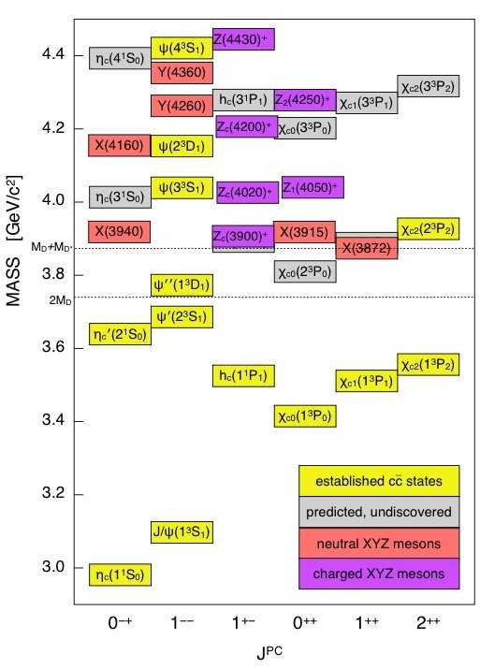
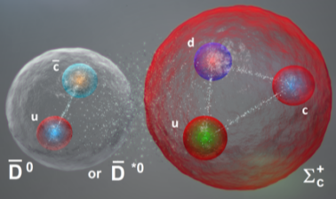
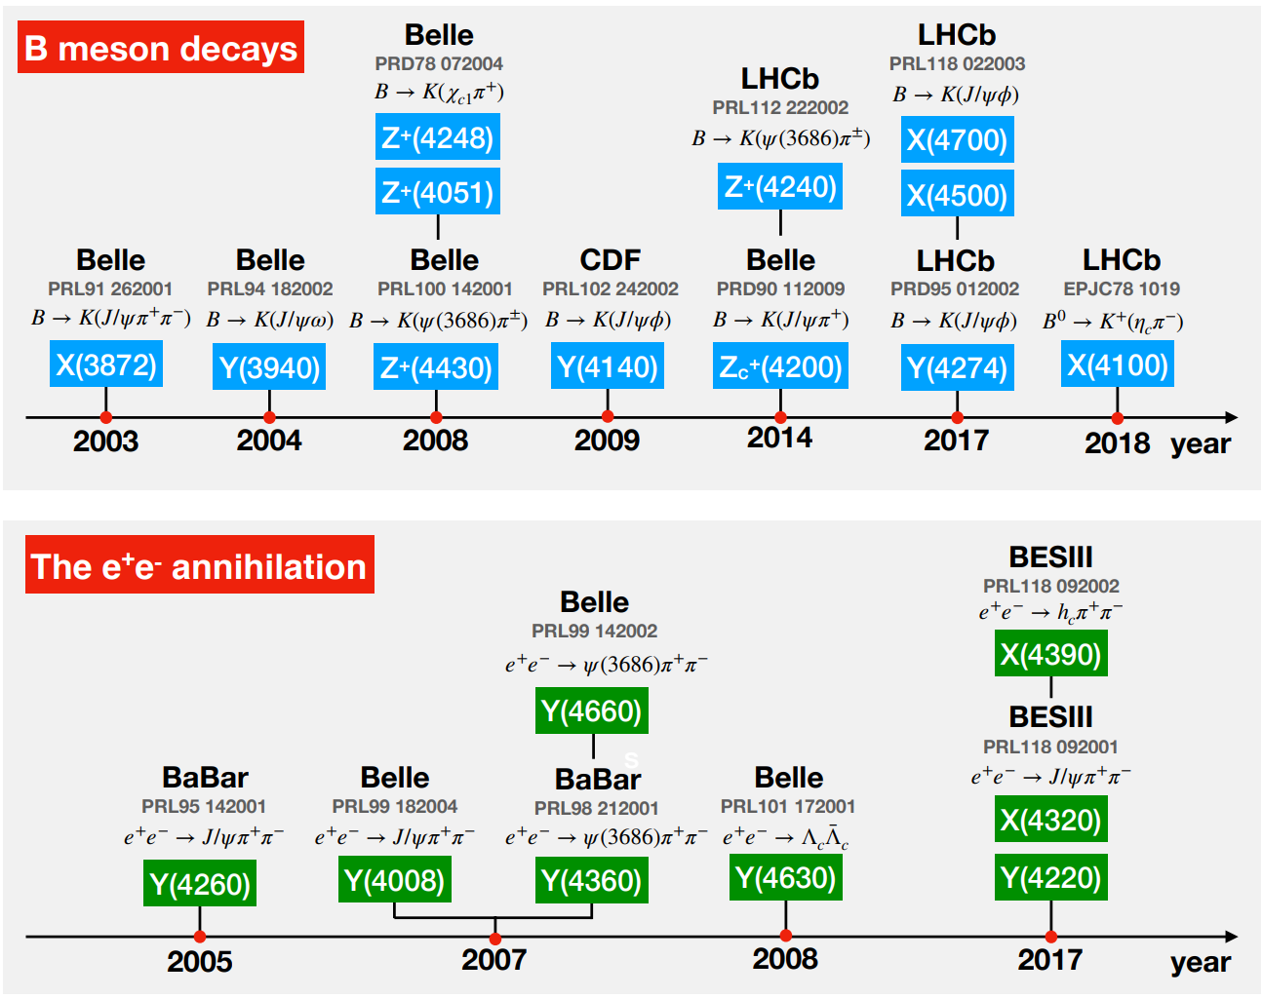
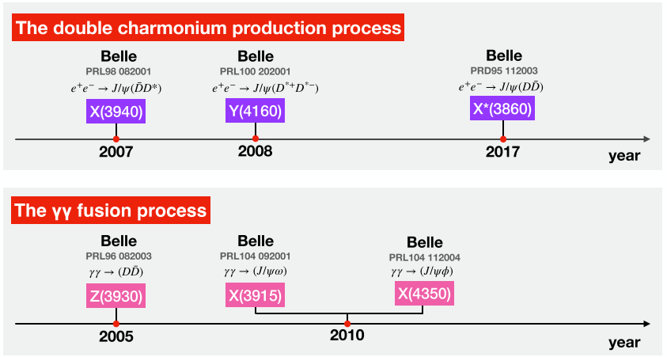
Brief introduction to exotic states
We study:
Exotic configurations and spin-parity
Production and decay mode
arXiv:1903.11976v2

Slide 3
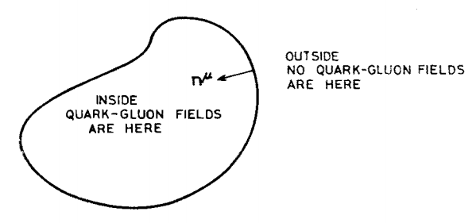
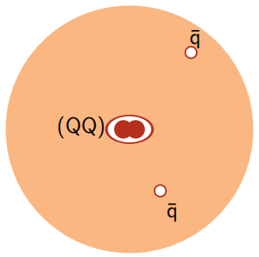
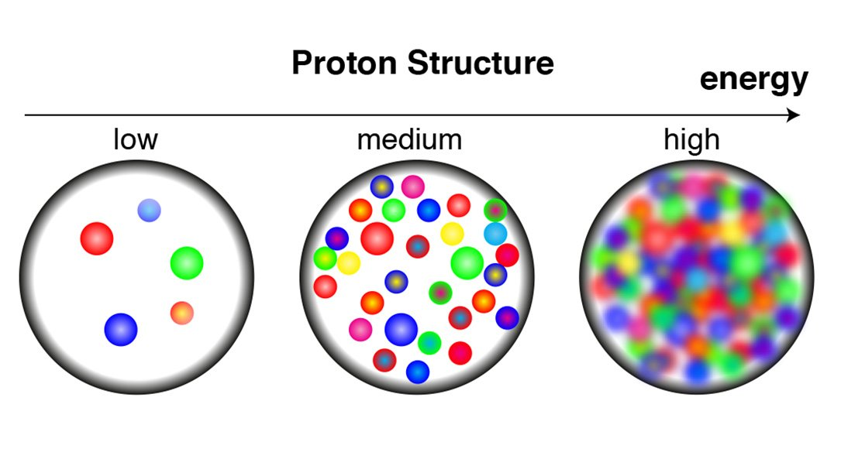
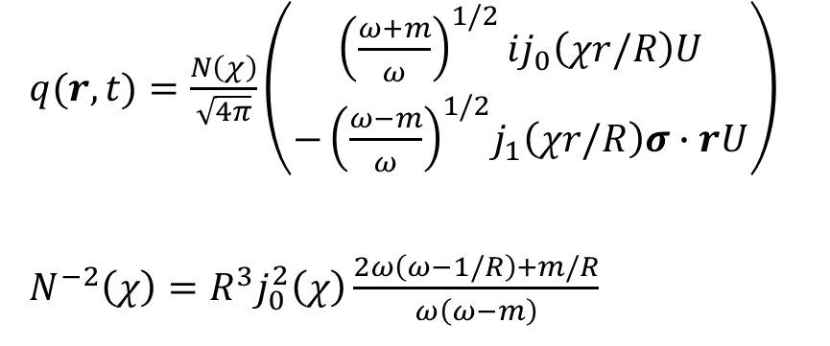
Why MIT Bag Model?
Physical picture of confinement
Expected to be adaptive for all possible multiquark states
Solution of Dirac equation
QGP (Quark-Gluon Plasma)
$q(r,t)=\frac{N\left(χ\right)}{\sqrt{4π}}\left(\begin{matrix}{\left(\frac{ω+m}{ω}\right)}^{1/2}ij_{0}\left(χr/R\right)U \\ {−\left(\frac{ω−m}{ω}\right)}^{1/2}j_{1}\left(χr/R\right)σ∙rU\end{matrix}\right)$
$N^{−2}\left(χ\right)=R^{3}j_{0}^{2}\left(χ\right)\frac{2ω\left(ω−1/R\right)+m/R}{ω\left(ω−m\right)}$

Slide 4
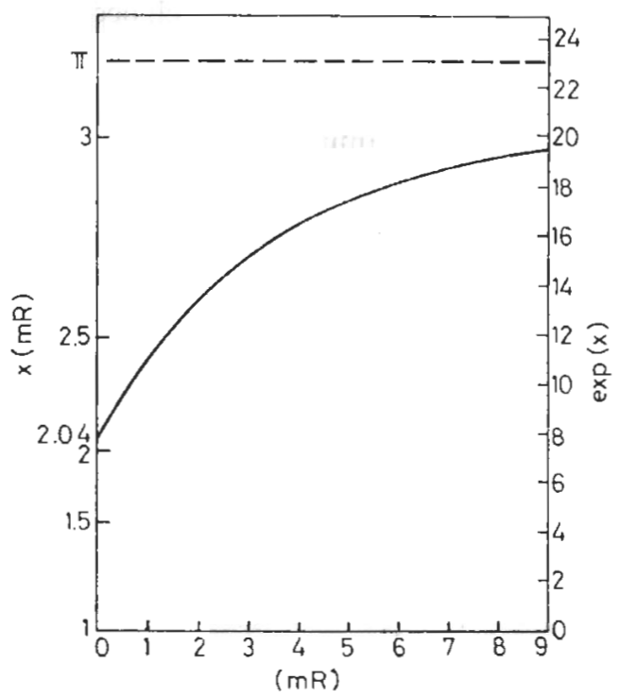
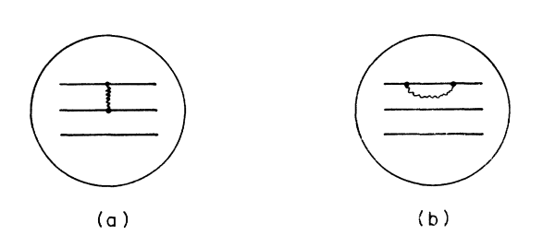
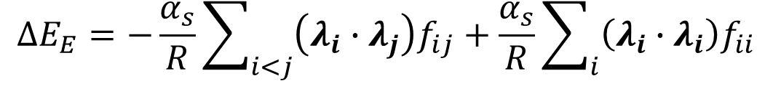
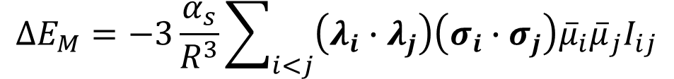

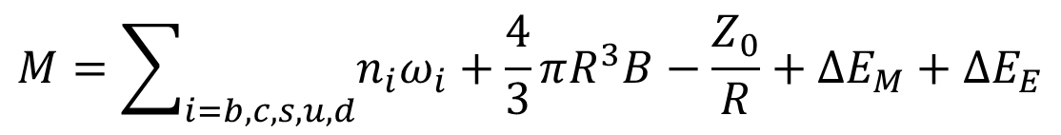
Mass formula in aspect of Bag Model
$$M=\sum_{i=b,c,s,u,d}{n_{i}ω_{i}}+\frac{4}{3}πR^{3}B−\frac{Z_{0}}{R}+ΔE_{M}+ΔE_{E}$$
Gluon Condensation
where $ω_{i}=\begin{aligned}{\left(m_{i}^{2}+x_{i}^{2}/R^{2}\right)}^{1/2}\#\end{aligned}$, and $x_{i}$ satisfies an eigenequation
$$\tan{x_{i}}=x_{i}/\left[1−m_{i}R−{\left(m_{i}^{2}R^{2}+x_{i}^{2}\right)}^{1/2}\right]$$
Interactions take the forms as
$$ΔE_{M}=−3\frac{α_{s}}{R^{3}}\sum_{i<j}{\left(λ_{i}∙λ_{j}\right)\left(σ_{i}∙σ_{j}\right){\overline{μ}}_{i}{\overline{μ}}_{j}I_{ij}}$$
$$ΔE_{E}=−\frac{α_{s}}{R}\sum_{i<j}{\left(λ_{i}∙λ_{j}\right)f_{ij}}+\frac{α_{s}}{R}\sum_{i}{\left(λ_{i}∙λ_{i}\right)f_{ii}}$$
T. DeGrand, 1975, Physical Review D
K. Johnson, 1975, ACTA Physica Polonica

Slide 5
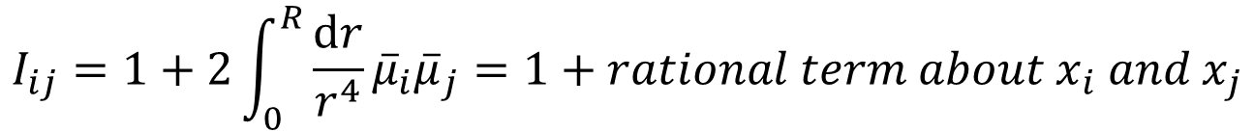
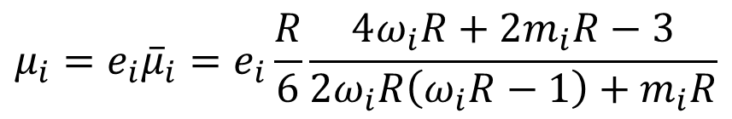
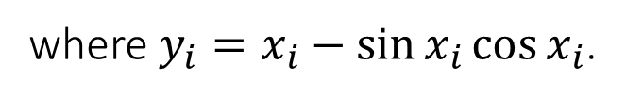
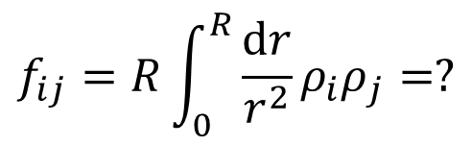
In the frame of MIT Bag Model, we can separate factors into specific expressions
$$μ_{i}=e_{i}{\overline{μ}}_{i}=e_{i}\frac{R}{6}\frac{4ω_{i}R+2m_{i}R−3}{2ω_{i}R\left(ω_{i}R−1\right)+m_{i}R}$$
$$I_{ij}=1+2\int_{0}^{R}{\frac{dr}{r^{4}}{\overline{μ}}_{i}{\overline{μ}}_{j}}=1+rational term about x_{i} and x_{j}$$
$$ρ_{i}=\frac{ω_{i}\left[x_{i}y_{i}−\left(\sin^{2}{x_{i}y_{i}}\right)/x_{i}y_{i}\right]−m_{i}\left[\sin{x_{i}y_{i}}\cos{x_{i}y_{i}}−\left(\sin^{2}{x_{i}y_{i}}\right)/x_{i}y_{i}\right]}{ω_{i}\left[x_{i}−\left(\sin^{2}{x_{i}}\right)/x_{i}\right]−m_{i}\left[\sin{x_{i}}\cos{x_{i}}−\left(\sin^{2}{x_{i}}\right)/x_{i}\right]}$$
$$f_{ij}=R\int_{0}^{R}{\frac{dr}{r^{2}}ρ_{i}ρ_{j}}=?$$
where $y_{i}=x_{i}−\sin{x_{i}}\cos{x_{i}}$.
We can use magnetic moment for each quark to evaluate the CMI within hadronic system.
But we can’t calculate CEI by integrating charge density for now.

Slide 6
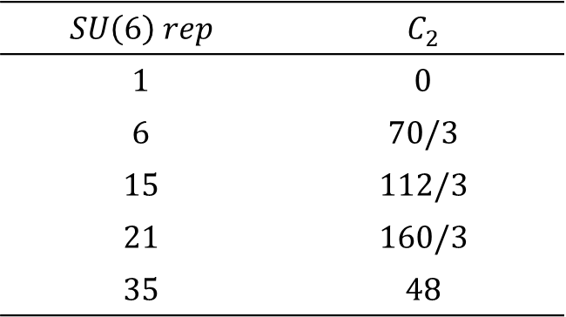
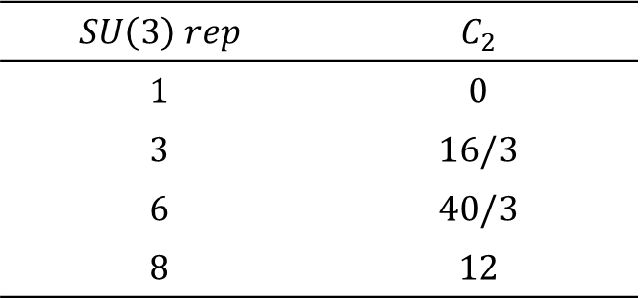
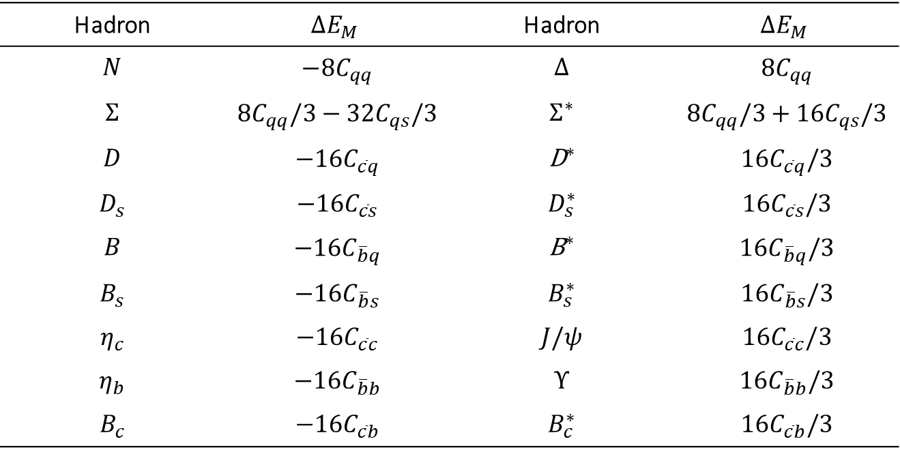
SU(6) group algebra & CMI Model
arXiv:1903.11976v2
Si-Qiang Luo, 2017, Eur. Phys. J. C
M. Karliner, 2017, PRD. 95, 034011
For a given flavor-spin-color wave function $φ$, we have an average of SU(6) operator
$$\left\langle φ | −\sum_{i<j}{\left(λ_{i}∙λ_{j}\right)\left(σ_{i}∙σ_{j}\right)} | φ\right\rangle =8N+\frac{4}{3}S\left(S+1\right)+2C_{2}\left[{SU\left(3\right)}_{c}\right]−4C_{2}\left[{SU\left(6\right)}_{cs}\right]$$
Hadron | $$ΔE_{M}$$ | Hadron | $$ΔE_{M}$$
$$N$$ | $$−8C_{qq}$$ | $$Δ$$ | $$8C_{qq}$$
$$Σ$$ | $$8C_{qq}/3−32C_{qs}/3$$ | $$Σ^{∗}$$ | $$8C_{qq}/3+16C_{qs}/3$$
$$D$$ | $$−16C_{\overline{c}q}$$ | $${\text{D}}^{∗}$$ | $$16C_{\overline{c}q}/3$$
$$D_{s}$$ | $$−16C_{\overline{c}s}$$ | $$D_{s}^{∗}$$ | $$16C_{\overline{c}s}/3$$
$$B$$ | $$−16C_{\overline{b}q}$$ | $${\text{B}}^{∗}$$ | $$16C_{\overline{b}q}/3$$
$$B_{s}$$ | $$−16C_{\overline{b}s}$$ | $$B_{s}^{∗}$$ | $$16C_{\overline{b}s}/3$$
$$η_{c}$$ | $$−16C_{\overline{c}c}$$ | $$J/ψ$$ | $$16C_{\overline{c}c}/3$$
$$η_{b}$$ | $$−16C_{\overline{b}b}$$ | $$Υ$$ | $$16C_{\overline{b}b}/3$$
$$B_{c}$$ | $$−16C_{\overline{c}b}$$ | $$B_{c}^{∗}$$ | $$16C_{\overline{c}b}/3$$
$$SU\left(3\right) rep$$ | $$C_{2}$$
$$1$$ | $$0$$
$$3$$ | $$16/3$$
$$6$$ | $$40/3$$
$$8$$ | $$12$$
$$SU\left(6\right) rep$$ | $$C_{2}$$
$$1$$ | $$0$$
$$6$$ | $$70/3$$
$$15$$ | $$112/3$$
$$21$$ | $$160/3$$
$$35$$ | $$48$$

Slide 7
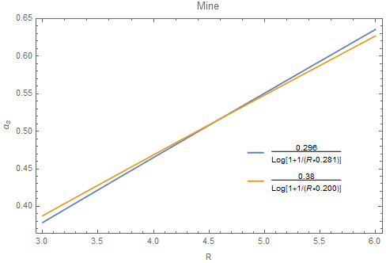
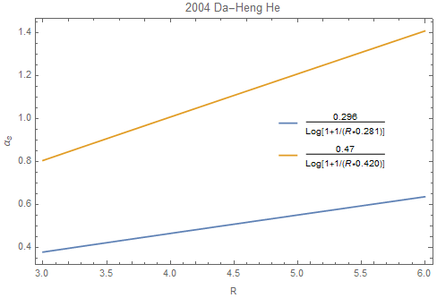
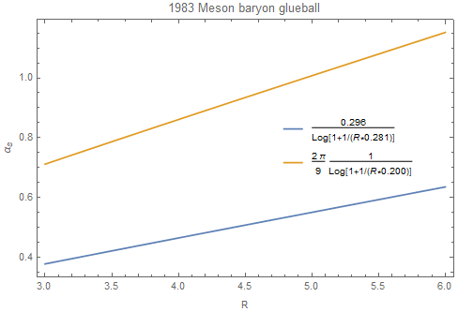
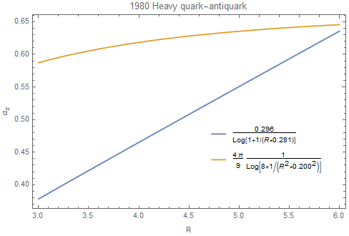
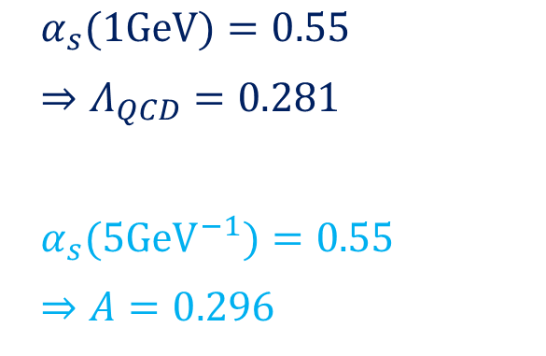
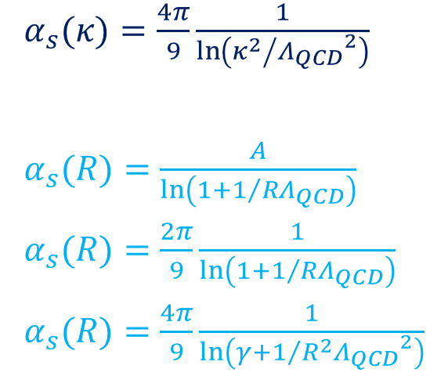
Running Coupling Constant
$α_{s}(κ)=\frac{4π}{9}\frac{1}{\ln\left({κ^{2}}/{{Λ_{QCD}}^{2}}\right)}$
$α_{s}(R)=\frac{A}{\ln\left(1+1/{RΛ_{QCD}}\right)}$
$α_{s}(R)=\frac{2π}{9}\frac{1}{\ln\left(1+1/{RΛ_{QCD}}\right)}$
$α_{s}(R)=\frac{4π}{9}\frac{1}{\ln\left(γ+1/{R^{2}{Λ_{QCD}}^{2}}\right)}$
$α_{s}(1GeV)=0.55$
$⇒Λ_{QCD}=0.281$
$α_{s}(5{GeV}^{−1})=0.55$
$⇒A=0.296$

Slide 8
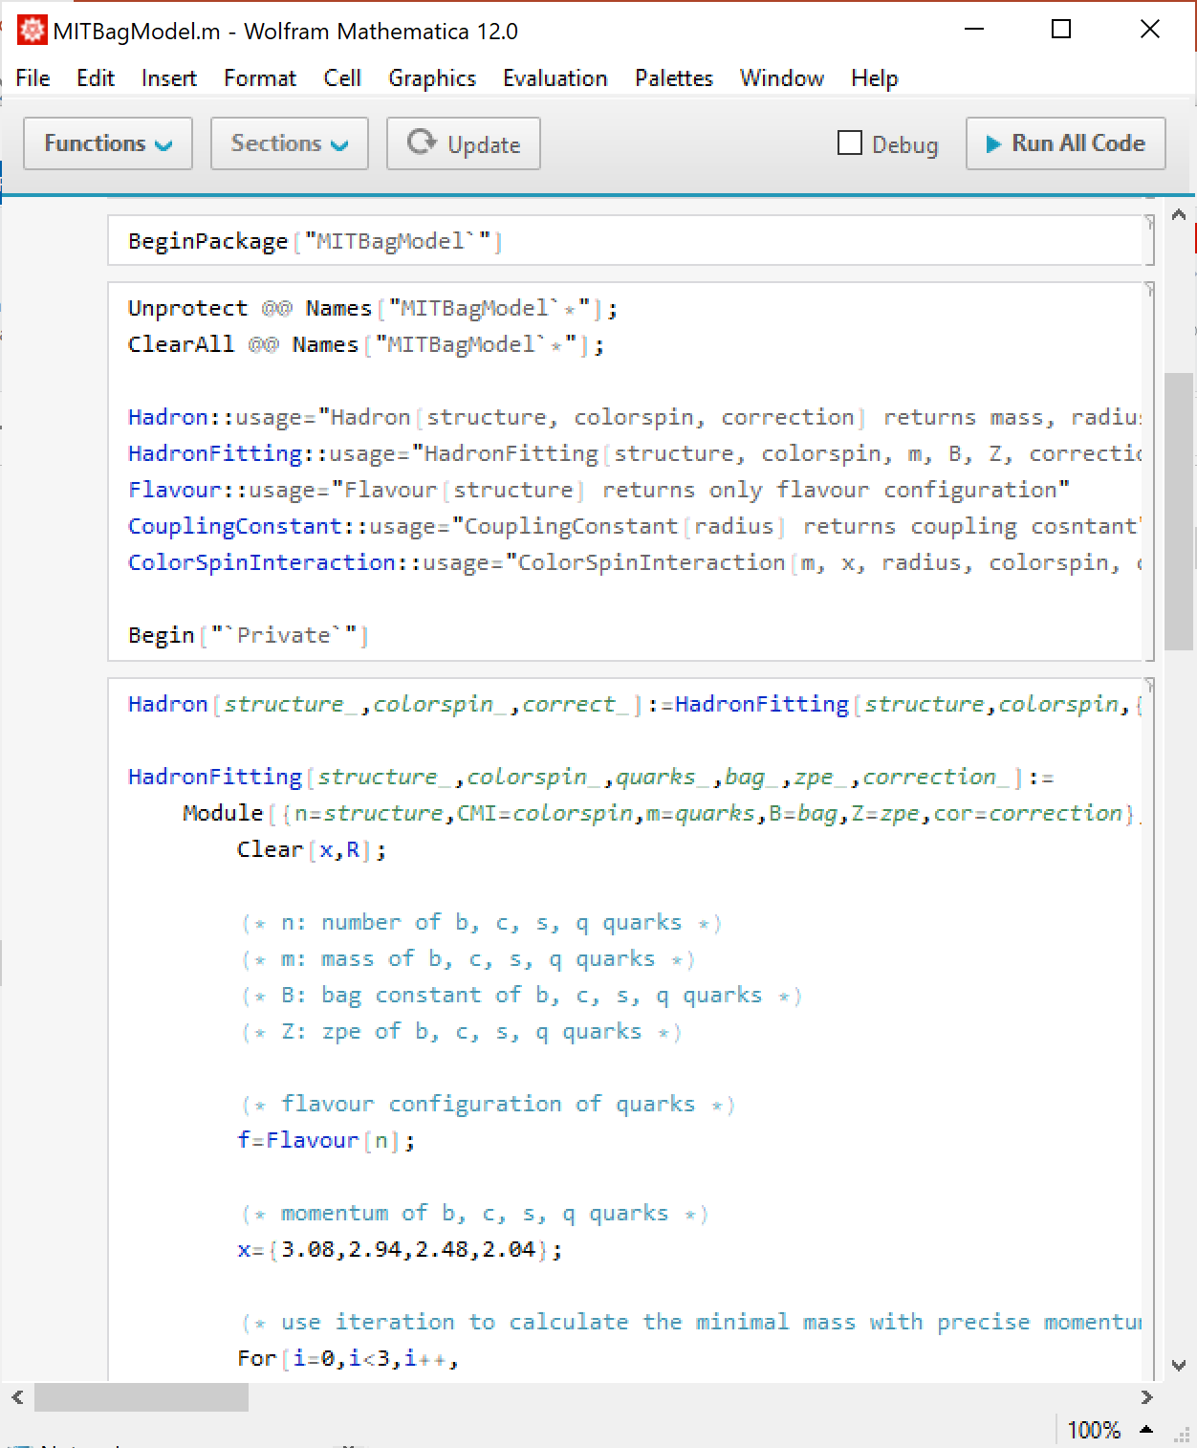
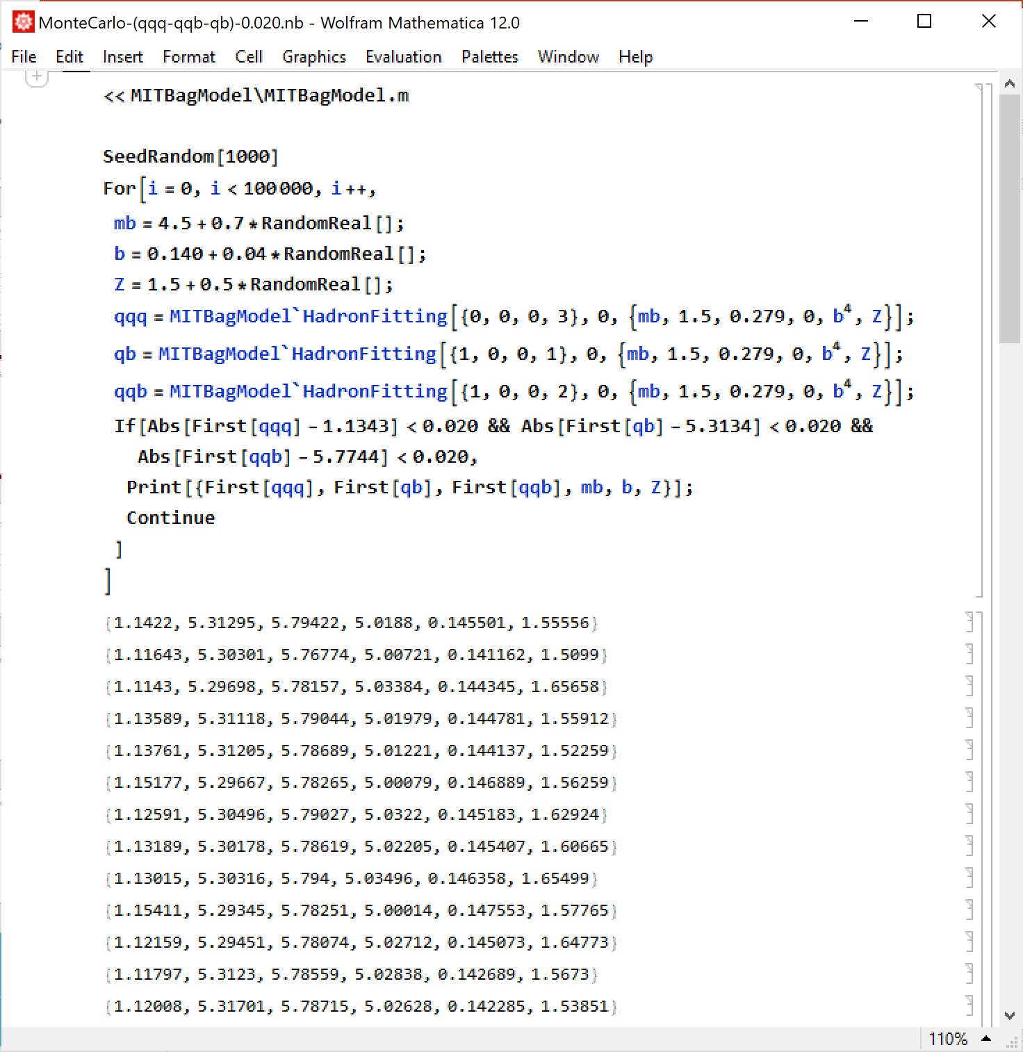
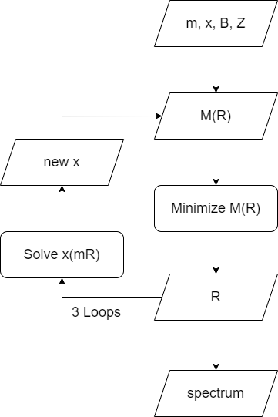
Our numerical calculation

Slide 9
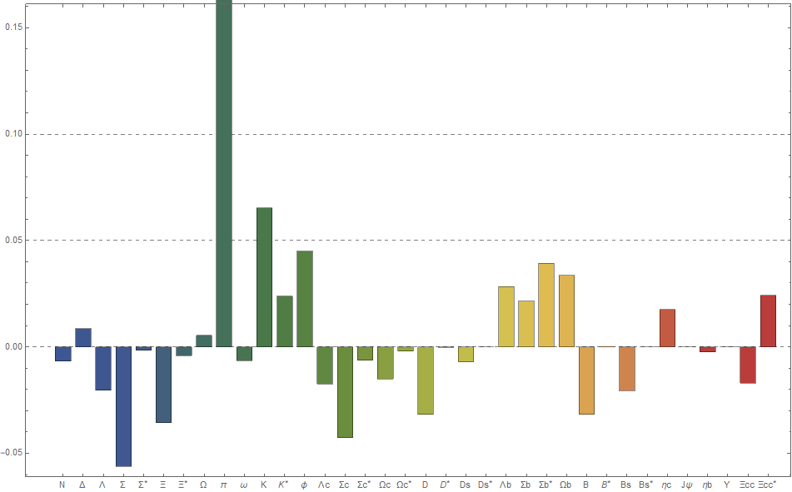
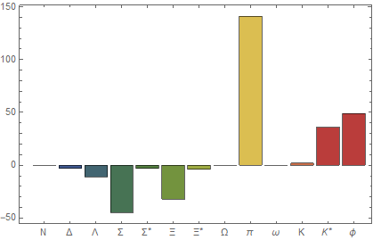
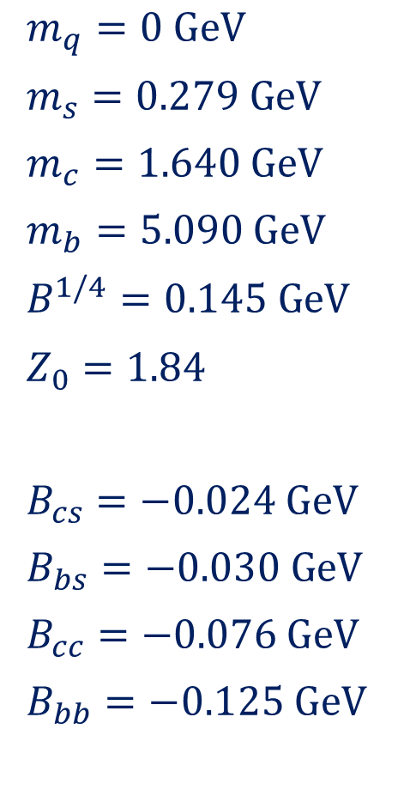
Mass Spectrum
K. Johnson, 1975, ACTA Physical Polonica
$m_{q}=0 GeV$
$m_{s}=0.279 GeV$
$m_{c}=1.640 GeV$
$m_{b}=5.090 GeV$
$B^{1/4}=0.145 GeV$
$Z_{0}=1.84$
$B_{cs}=−0.024 GeV$
$B_{bs}=−0.030 GeV$
$B_{cc}=−0.076 GeV$
$B_{bb}=−0.125 GeV$
Error Bar

Slide 10
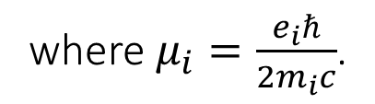
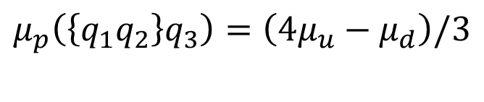
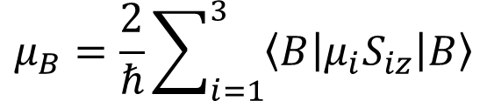
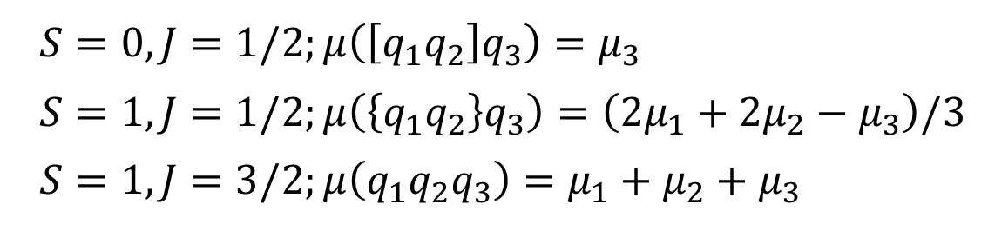
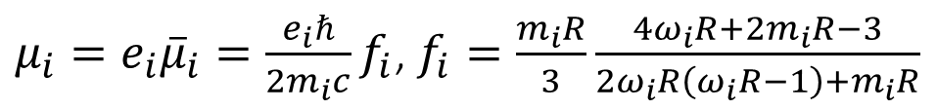
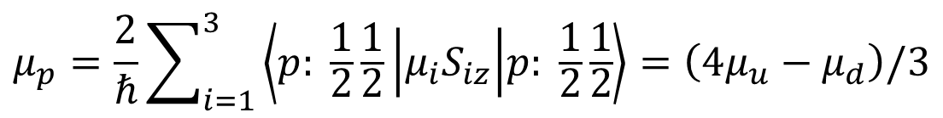
Magnetic Moments
The book Introduction to Elementary Particles gives the following calculation
$$μ_{B}=\frac{2}{ℏ}\sum_{i=1}^{3}{\left\langle B | μ_{i}S_{iz} | B\right\rangle }$$
where $μ_{i}=\frac{e_{i}ℏ}{2m_{i}c}$.
$$μ_{p}=\frac{2}{ℏ}\sum_{i=1}^{3}{\left\langle p: \frac{1}{2}\frac{1}{2} | μ_{i}S_{iz} | p: \frac{1}{2}\frac{1}{2}\right\rangle }=\left(4μ_{u}−μ_{d}\right)/3$$
In the frame of MIT Bag & Quark Model, we have summarized method
$μ_{i}=e_{i}{\overline{μ}}_{i}=\frac{e_{i}ℏ}{2m_{i}c}f_{i}$, $f_{i}=\frac{m_{i}R}{3}\frac{4ω_{i}R+2m_{i}R−3}{2ω_{i}R\left(ω_{i}R−1\right)+m_{i}R}$
$$μ_{p}\left(\left\{q_{1}q_{2}\right\}q_{3}\right)=\left(4μ_{u}−μ_{d}\right)/3$$
$S=0, J=1/2;μ\left(\left[q_{1}q_{2}\right]q_{3}\right)=μ_{3}$
$S=1, J=1/2;μ\left(\left\{q_{1}q_{2}\right\}q_{3}\right)=\left(2μ_{1}+2μ_{2}−μ_{3}\right)/3$
$S=1, J=3/2;μ\left(q_{1}q_{2}q_{3}\right)=μ_{1}+μ_{2}+μ_{3}$
A. Bernotas, Lithuanian Journal of Physics, 2013
David Griffiths, Introduction to Elementary Particles

Slide 11
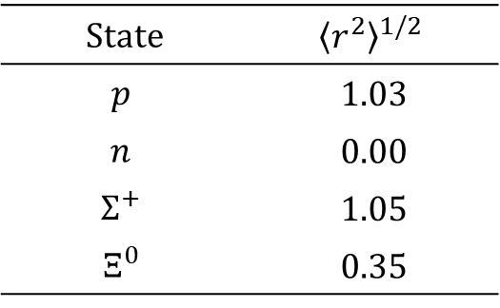
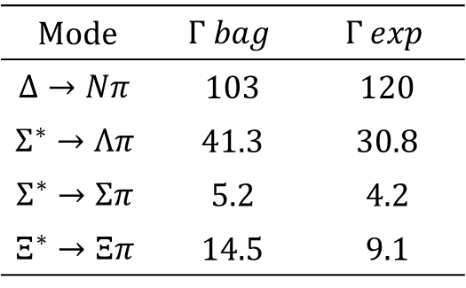
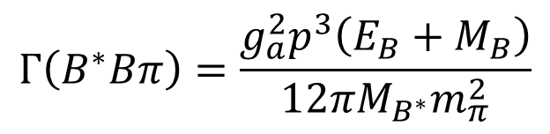
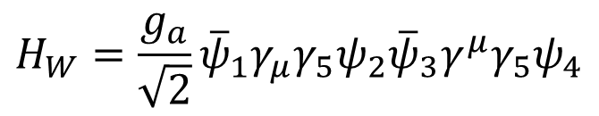
Other quantities
T. DeGrand, 1975, Physical Review D
We may study axial-vector coupling constant and mean square charge radius
$${\left(g_{a}\right)}_{ij}=\frac{2x_{i}x_{j}}{3\left(x_{i}^{2}−x_{j}^{2}\right)}\frac{2\left(ω_{i}−ω_{j}\right)R+m_{i}R−m_{j}r}{{\left[2ω_{i}R\left(ω_{i}R−1\right)+m_{i}R\right]}^{1/2}{\left[2ω_{j}R\left(ω_{j}R−1\right)+m_{j}R\right]}^{1/2}}$$
$${\left\langle r^{2}\right\rangle }_{i}=e_{i}\frac{ω_{i}R^{3}\left[2x_{i}^{2}\left(ω_{i}R−1\right)+4ω_{i}R+2m_{i}R−3\right]−3m_{i}R^{3}\left[4ω_{i}R+2m_{i}R−2x_{i}^{2}−3\right]/2}{3x_{i}^{2}\left[2ω_{i}R\left(ω_{i}R−1\right)+m_{i}R\right]}$$
and Gamow-Teller decay mode $1→2+3+4$
$$H_{W}=\frac{g_{a}}{\sqrt{2}}{\overline{ψ}}_{1}γ_{μ}γ_{5}ψ_{2}{\overline{ψ}}_{3}γ^{μ}γ_{5}ψ_{4}$$
J. F. Donoghue, 1975, Physical Review D
Mode | $$Γ bag$$ | $$Γ exp$$
$$Δ→Nπ$$ | 103 | 120
$$Σ^{∗}→Λπ$$ | 41.3 | 30.8
$$Σ^{∗}→Σπ$$ | 5.2 | 4.2
$$Ξ^{∗}→Ξπ$$ | 14.5 | 9.1
State | $${\left\langle r^{2}\right\rangle }^{1/2}$$
$$p$$ | 1.03
$$n$$ | 0.00
$$Σ^{+}$$ | 1.05
$$Ξ^{0}$$ | 0.35
$$Γ\left(B^{∗}Bπ\right)=\frac{g_{a}^{2}p^{3}\left(E_{B}+M_{B}\right)}{12πM_{B^{∗}}m_{π}^{2}}$$

Slide 12
Questions and Prospect
Reduce the errors of mass spectrum
Mass spectrum of exotic states
CMI and magnetic moments
Mean square charge radius
Weak and radiative decay modes
12/2020-1/2021
Mass, CMI, Radius, Magnetic Moment.
2/2021-3/2021
Decay Mode. Submit our paper.
4/2021-6/2021
Reply reviewer's comments.
All start with mass spectrum!!!

Slide 13

$$Tha\text{nk} \text{you}$$

